Slide 1
CAEP Office Hour
Neil Kelly – State CAEP Office
Veronica Parker – CAEP TAP
April 24, 2020

Slide 2
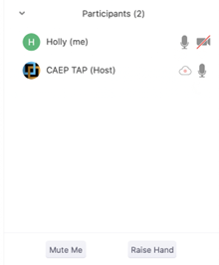

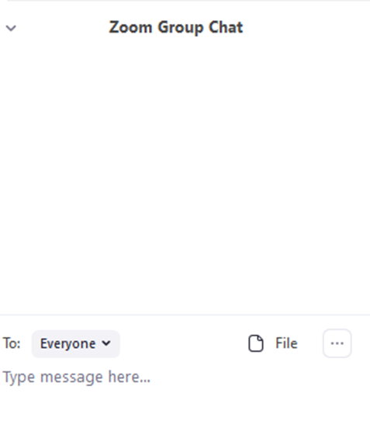


Zoom Room Controls
Everyone has the ability to speak…please raise your hand first
Everyone is muted upon entry
Feel free to communicate via the chat – even share files
You can use your camera…or not

Slide 3

Questions?
Announcements
Google Group
CAEP Update Report
OTAN & CASAS webinars
Short Term
20-21 Allocations
CFADs
Carry Over
EC 84914
Long Term
Statewide averages
Goal Setting
Performance
Next 3 year plan

Slide 4

Wrap Up and Questions

Slide 5
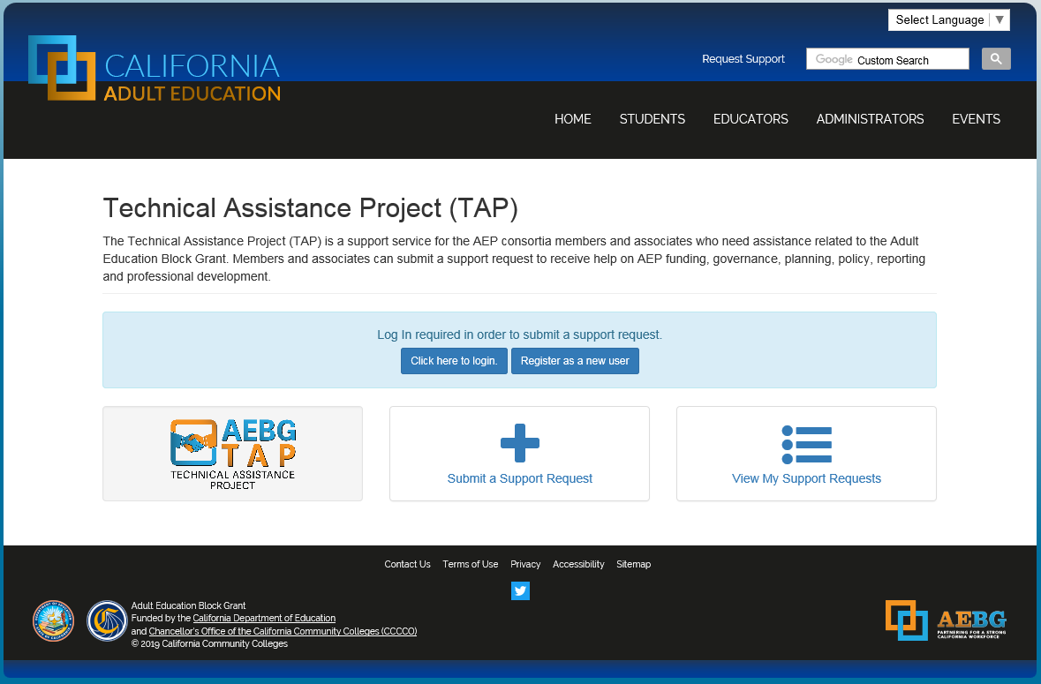
Request Support from CAEP TAP

