Slide 1
CAEP Office Hour
Neil Kelly – State CAEP Office
Veronica Parker – CAEP TAP
May 29, 2020

Slide 2
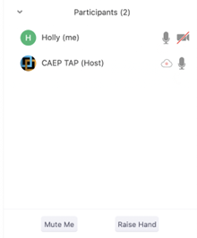

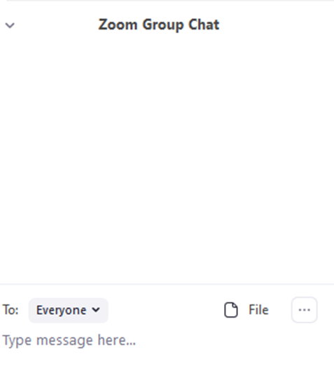


Zoom Room Controls
Everyone has the ability to speak…please raise your hand first
Everyone is muted upon entry
Feel free to communicate via the chat – even share files
You can use your camera…or not

Slide 3

Revised CFAD
Annual Plan Due August 15
TOPSPro Data EOY due August 1
CAEP Q3 Expenditure Report Due June 30

Slide 4

Wrap Up and Questions

Slide 5
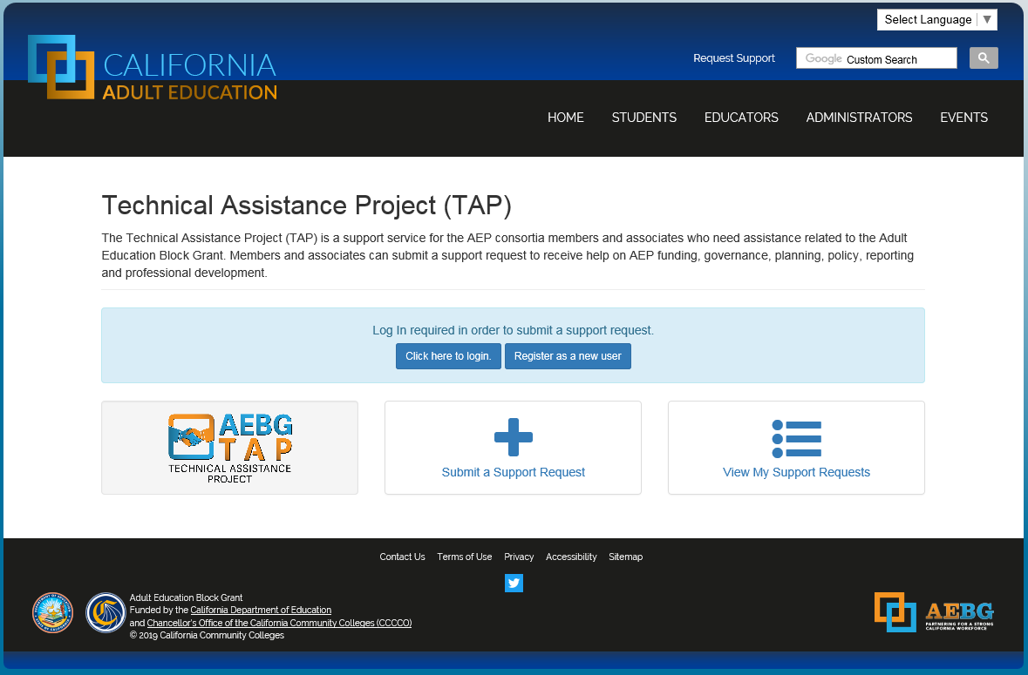
Request Support from CAEP TAP

