Slide 1
CAEP Office Hour
Neil Kelly – State CAEP Office
June 12, 2020

Slide 2
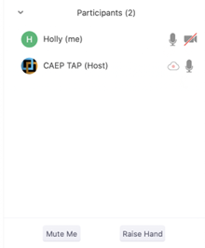

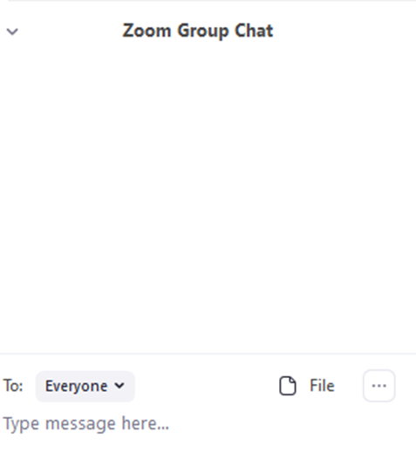


Zoom Room Controls
Everyone has the ability to speak…please raise your hand first
Everyone is muted upon entry
Feel free to communicate via the chat – even share files
You can use your camera…or not

Slide 3

2020-21 Budget
Reporting Reminders
CAEP Disbursements
Planning
Summer Schedule Update
Summit Update

Slide 4

Wrap Up and Questions

Slide 5
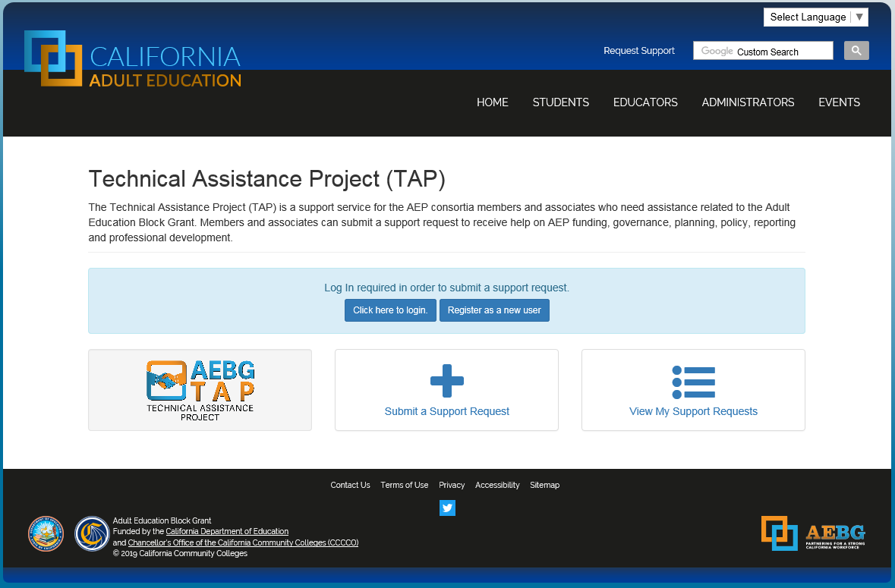
Request Support from CAEP TAP

